Slide 2
a library for efficient text classification and word representation
Piotr Bojanowski
November 23th, 2016

Slide 3
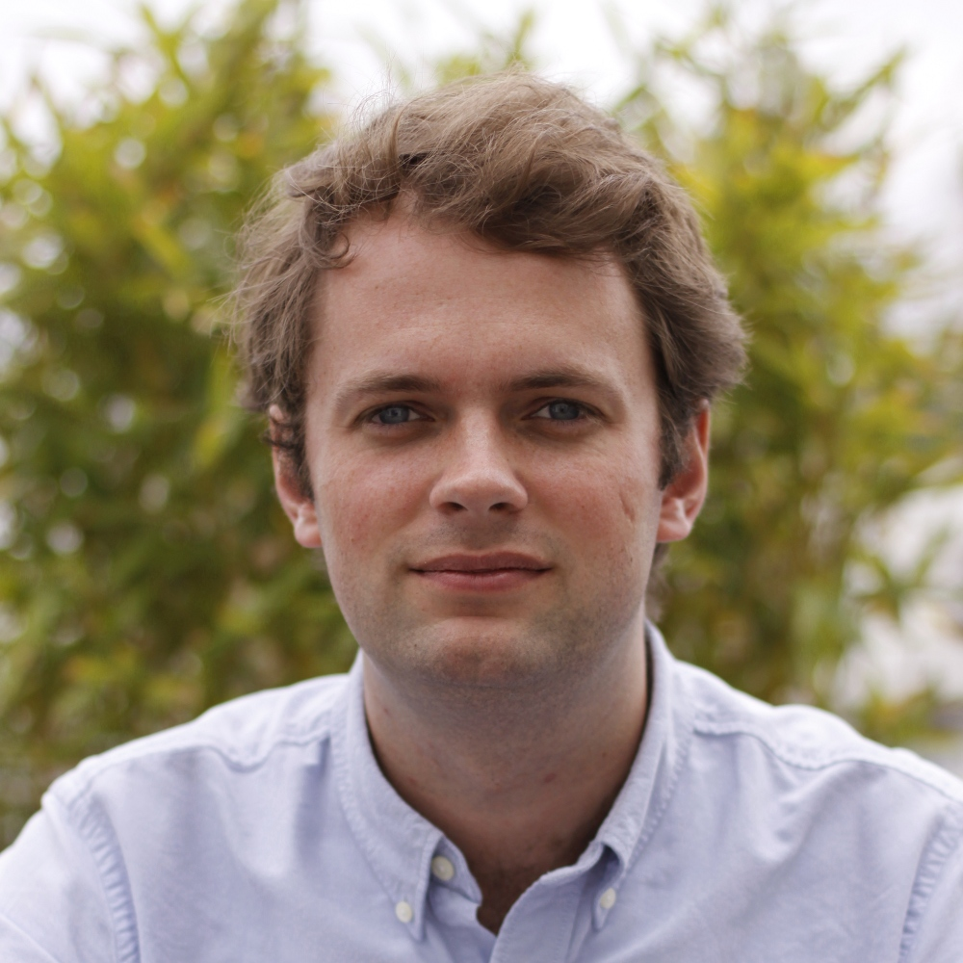
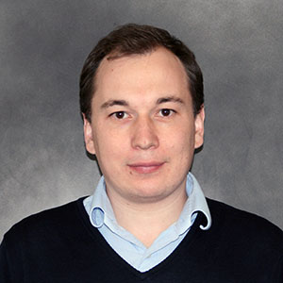
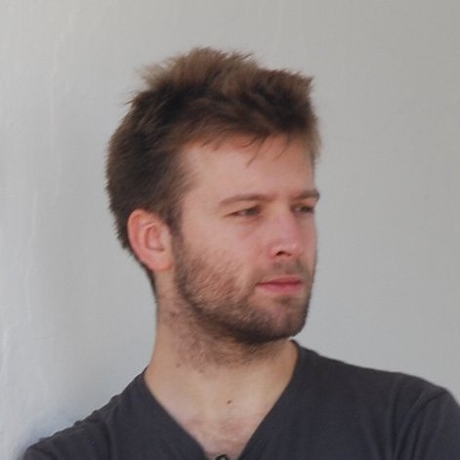

Collaborators
Piotr Bojanowski
Edouard Grave
Armand Joulin
Tomáš Mikolov

Slide 4
Scientific context
Representing words as vectors
Several drawbacks:
No sentence representations
Not exploiting morphology
Bleeding simple and fast -> widely used
[Mikolov et al. 2013]
Distributed Representations of Words and Phrases and their Compositionality
Efficient Estimation of Word Representations in Vector Space
Taking the average pre-trained word vector is popular
But does not work very well…
Words with same radicals don’t share parameters
disastrous / disaster
mangera / mangerai
Notes:
Representations as word2vec
Parler des downstream tasks
- A la fin de la slide on n’est pas vraiment motive -> changement de titre

Slide 5
Goal of the library
Unified framework for
Text representation
Text classification
Core of the library: given a set of indices –> predict an index
cbow, skip-gram and bow text classification are instances of this model
Many words
Many words
word
word
word
label
cbow
Skip-gram
text classification

Slide 6
Two main applications
Text classification
Word representation (with character-level features)
fenomeno inter is an italian sports magazine entirely dedicated to the football club football club internazionale milano . it is released on a monthly basis . it features articles posters and photos of inter players including both the first team players and the youth system kids as well as club employees . it also feature anecdotes and famous episodes from the club ' s history .
Written Work
“Je mangerai bien une pomme!”
ange
je
mang
erai
gera
bien
man
ang
era
une
nge
ger
rai
nger
pomme

Slide 7
Background knowledge
The skip-gram and cbow models of word2vec

Slide 8
The cbow and skipgram models
[Mikolov et al. 2013]

Slide 9
The skip-gram model
knight
The
Model probability of a context word given a word
Word vectors
knight
mighty
knight
Lancelot
The
mighty
knight
Lancelot
fought
bravely.
knight
fought
knight
bravely.

Slide 10
Background: the skip-gram model
Minimize a negative log likelihood:
The above sum hides co-occurrence counts
Computationally intensive!
Notes:
Duplicate this slide
Provide better illustration of skip-gram
Provide sentence example of what is w what is c

Slide 11
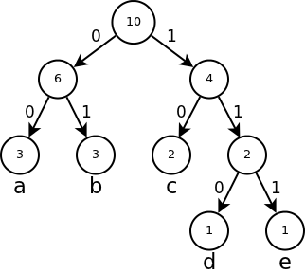
Approximations to the loss
Replace the multiclass loss by a set of binary logistic losses
Negative sampling
Hierarchical softmax
Notes:
Mettre une slide entre ca et les resultats

Slide 12
The cbow model
mighty
The
Model probability of a word given a context
Continuous Bag Of Words
bravely.
knight
fought
The
mighty
knight
Lancelot
fought
bravely.
Lancelot
Notes:
Provide illustration of what is w and what is the context

Slide 13
fasttext
Both models are instances of a broader set of models
Different input and output dictionaries
Common core but different pooling strategies
Efficient and modular C++ implementation
Allows easy building of extensions by writing own pooling

Slide 14
Bag of Tricks for Efficient Text Classification

Slide 15
Fast text classification
BoW model on text classification and tag prediction
A very strong (and fast) baseline, often on-par with SOTA approaches
Ease of use is at the core of the library
Starsmith (born Finlay Dow-Smith 8 July 1988 Bromley England) is a British songwriter producer remixer and DJ. He studied a classical music degree at the University of Surrey majoring in performance on saxophone. He has already received acclaim for the remixes he has created for Lady Gaga Robyn Timbaland Katy Perry Little Boots Passion Pit Paloma Faith Marina and the Diamonds and Frankmusik amongst many others.
Rikkavesi is a medium-sized lake in eastern Finland. At approximately 63 square kilometres (24 sq mi) it is the 66th largest lake in Finland. Rikkavesi is situated in the municipalities of Kaavi Outokumpu and Tuusniemi.Rikkavesi is 101 metres (331 ft) above the sea level. Kaavinjärvi and Rikkavesi are connected by the Kaavinkoski Canal. Ohtaansalmi strait flows from Rikkavesi to Juojärvi.
ARTIST
Natural Place
./fasttext supervised -input data/dbpedia.train -output data/dbpedia
./fasttext test data/dbpedia.bin data/dbpedia.test

Slide 16
Model
Model probability of a label given a paragraph
Paragraph feature
Word vectors are latent and not useful per se
If scarce supervised data, use pre-trained word vectors

Slide 17
n-grams
Possible to add higher-order features
Avoid building n-gram dictionary
minute
could listen
every day
I could listen to every track
every minute of every day.
of
day
every minute
I
every
track
listen to
minute of
of every
to
every
track every
could
every
listen
I could
every track
to every
Use a hashed dictionary!

Slide 18
Sentiment analysis - performance
Notes:
Present the baselines

Slide 19
Sentiment analysis - runtime

Slide 20
Tag prediction
Using Flickr Data
Given an image caption
Predict the most likely tag
Sample outputs:
Notes:
Talk about tagspace, what it is

Slide 21
Enriching Word Vectors with Sub-word Information

Slide 22
Exploiting sub-word information
Represent words as sum of its character n-grams
We add special positional characters:
All ending n-grams have special meaning
Grammatical variations still share most of n-grams
Compound nouns are easy to model
^mangerai$
 | Singular | Plural
Nominative | uniwersytet | uniwersytety
Genetive | uniwersytetu | uniwersytetów
Dative | uniwersytetowi | uniwersytetom
Accusative | uniwersytet | uniwersytety
Instrumental | uniwersytetem | uniwersytetami
Locative | uniwersytecie | uniwersytetach
Vocative | uniwersytecie | uniwersytety
Polish declension
Tisch
Tennis
Tischtennis

Slide 23
Model
As in skip-gram: model probability of a context word given a word
Feature of a word computed using n-grams:
As for the previous model, use hashing for n-grams
mang
erai
ange
man
ang
gera
era
mangerai
nge
ger
rai
nger
Character n-grams
Word itself

Slide 24
OOV words
Possible to build vectors for unseen words!
Evaluated in our experiments vs. word2vec
mang
ange
erai
man
ang
gera
era
mangerai
nge
ger
rai
nger
Character n-grams
Word itself

Slide 25
Word similarity
Given pairs of words
Human judgement of similarity
Similarity given vectors
Spearman’s rank correlation
Works well for rare words and morphologically rich languages!
Notes:
Explain the datasets
Explain the baselines
Difference between ours* and ours
Provide example from a dataset

Slide 26
Word analogies
Given triplets of words:
Predict the analogy
Evaluated using accuracy
Works well for syntactic analogies
Does not degrade semantic much
Notes:
Provide example form a dataset
Not evaluating on OOV for obvious reasons

Slide 27
Comparison to state-of-the-art methods

Slide 28
Qualitative results

Slide 29
Conclusion

Slide 30
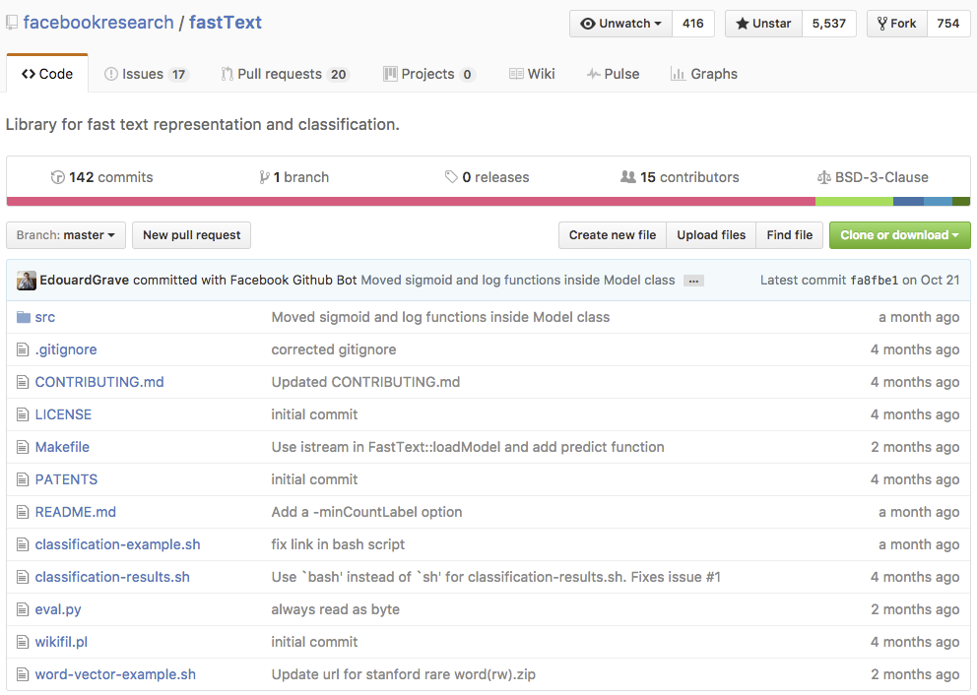
fasttext is open source
Available on Github
After 4 months:
> 5500 stars!
1.3k members FB group
Featured in “popular” press
C++ code
Bash scripts as examples
Very simple usage
Several OS projects
Python wrapper
Docker files

Slide 31
Questions

